Slide 1
Lecture 13:GANS Variants
CPSC/AMTH 452/552
CBB 663

Slide 2
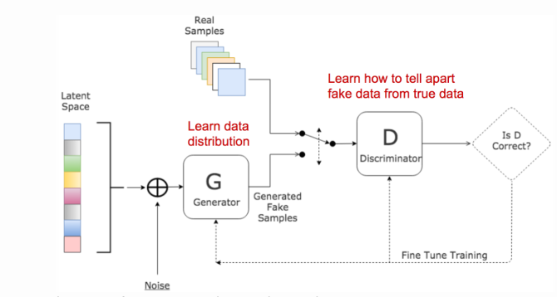
Generative Adversarial Network
Goodfellow et al. 2014

Slide 3
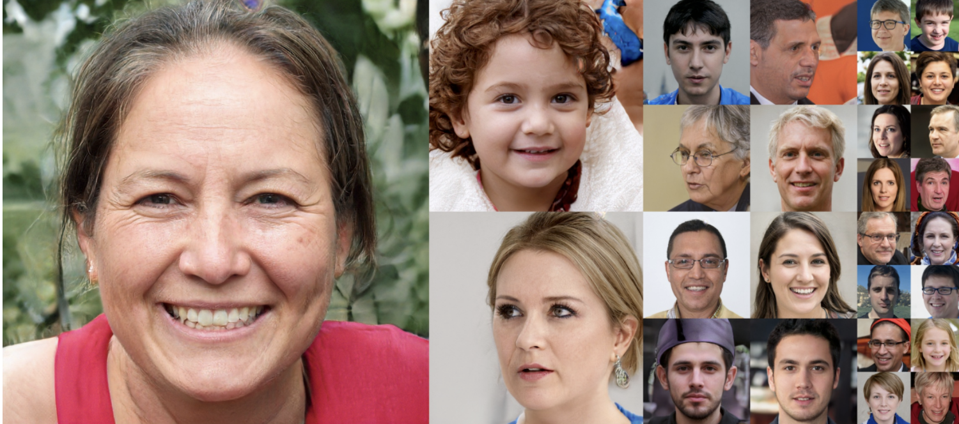
Are these faces real or fake?

Slide 4
disentangled representation

Slide 5
Increased Control Over Generation
Key to realistic generation is control over which vectors map to which features
This allows for tuning of noise ”like a knob”
StyleGAN, InfoGAN and other methods use this approach
Unsupervised approach:
Take a vector that generates a man x
Take a vector that generates a man with glasses y
Take a woman z
z+(x-y) should put glasses on the woman!

Slide 6
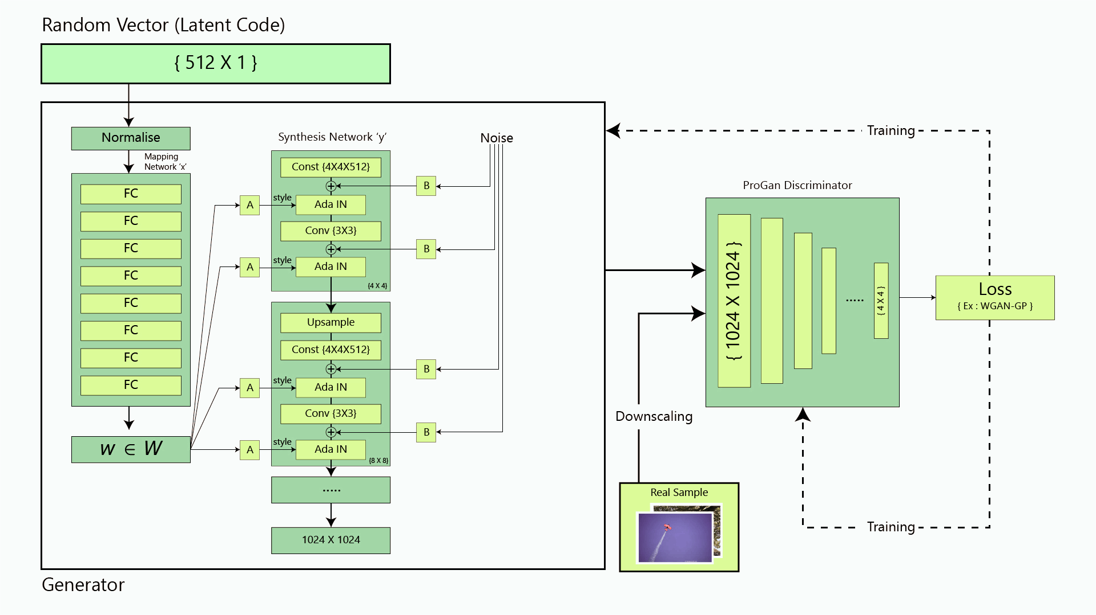




StyleGAN
Random vector (latent code)
Synthesis network
Discriminator
Mapping network
Real data
Generator

Slide 7
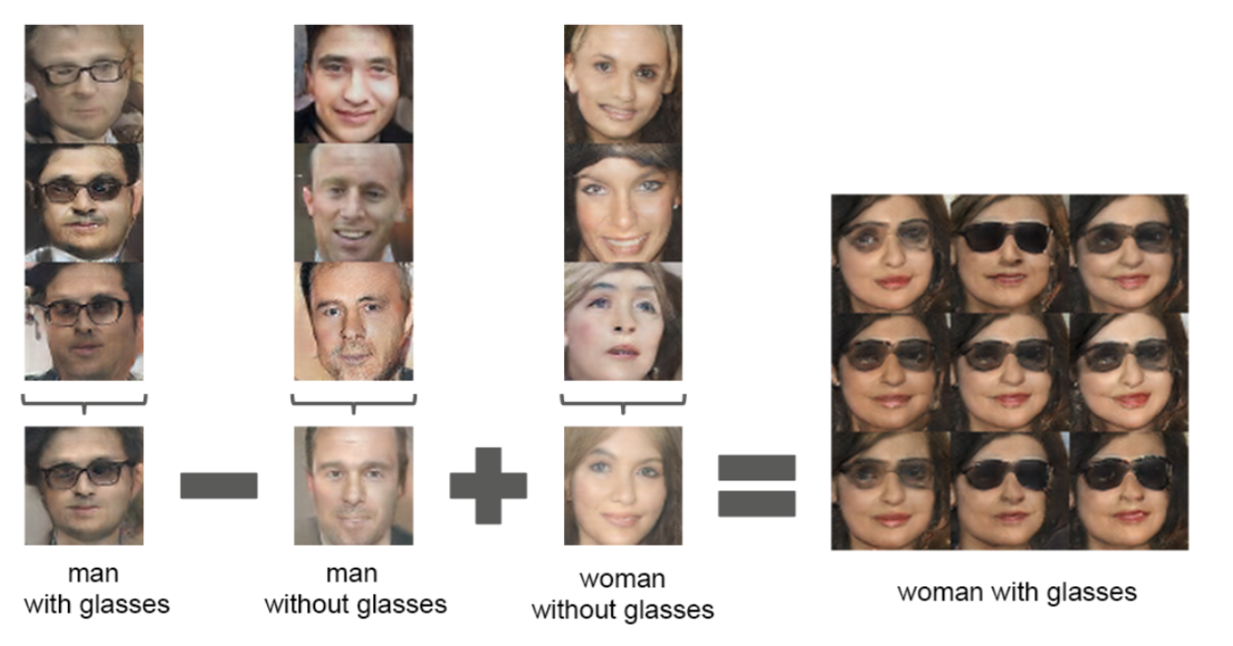
styleGAN: Learning realistic generation
https://www.youtube.com/watch?v=kSLJriaOumA

Slide 8
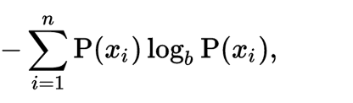
Entropy as a measure of uncertainty
Y Spread
in X-Slice
Y Spread
Measure of Uncertainty in a random variable.
X-Slice
Units of bits tells us how many bits are needed to represent the outcome
Notes:
At its core mutual information determines how the spread of a variable Y decreases as you condition on another variables X. But mutual information works when there is an even samplign along the dynamic range.

Slide 9
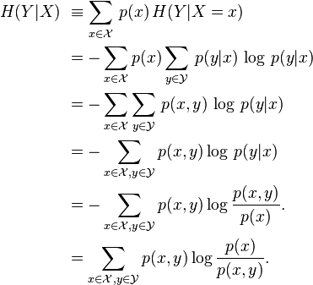
Conditional Entropy
Can conditioning increase
entropy??
Y Spread
In X-Slice
No.
H(Y|X)<= H(Y)
X-Slice
Measure of Uncertainty in a random variable
given knowledge about another variable
Notes:
At its core mutual information determines how the spread of a variable Y decreases as you condition on another variables X. But mutual information works when there is an even samplign along the dynamic range.

Slide 10
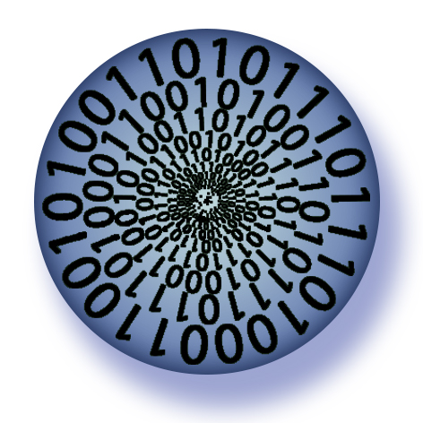
Mutual Information
Y Spread
in X-Slice
Y Spread
X-Slice
Mutual Information: I(X,Y) = H(Y) –H(Y|X)
Notes:
At its core mutual information determines how the spread of a variable Y decreases as you condition on another variables X. But mutual information works when there is an even samplign along the dynamic range.

Slide 11
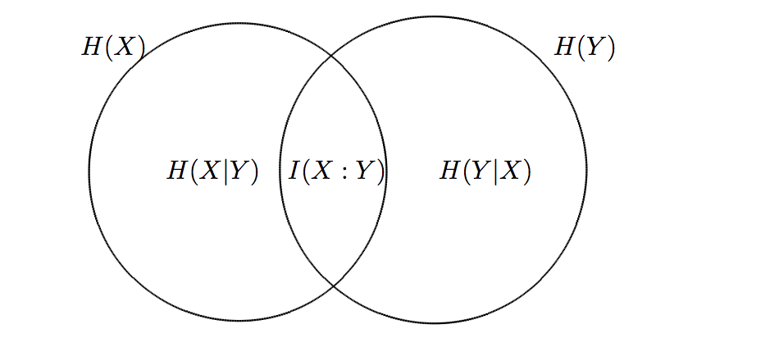
Entropy and Mutual Information

Slide 12
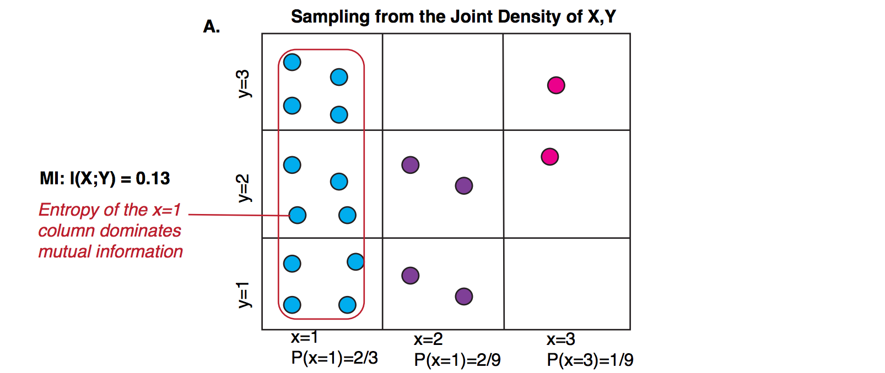
MI Computation

Slide 13
Trends with High and Low MI
Low MI
High MI
Notes:
MI is a good metric, but it does not work for the same reason that density estimates do not work. It is “distracted” by the round dense spot in the data. Change the line from sigmoid

Slide 14
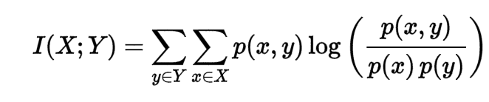
Another Definition
Compares joint to marginal distributions
What is the difference in entropy between joint and product of marginals ?

Slide 15
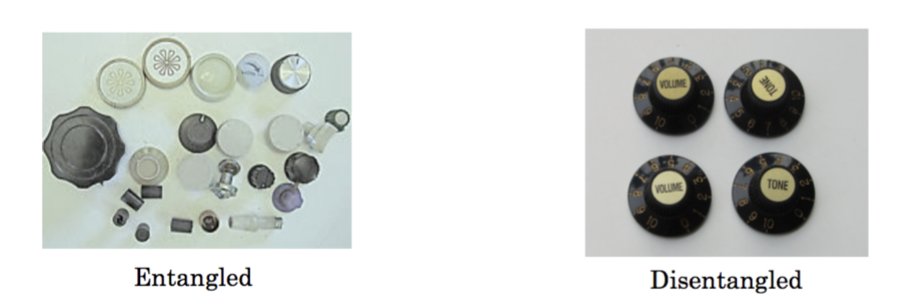
InfoGAN
Info GAN tries to provide a naturally disentangled latent code to do this
In other words it tries to make the knobs separated from the start

Slide 16
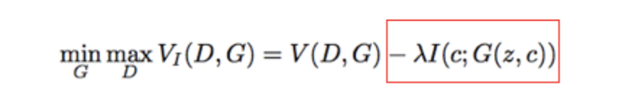
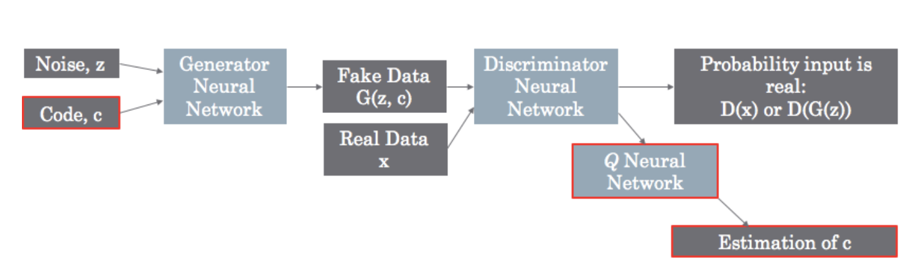
Mutual Information Term
Actual Architecture

Slide 17
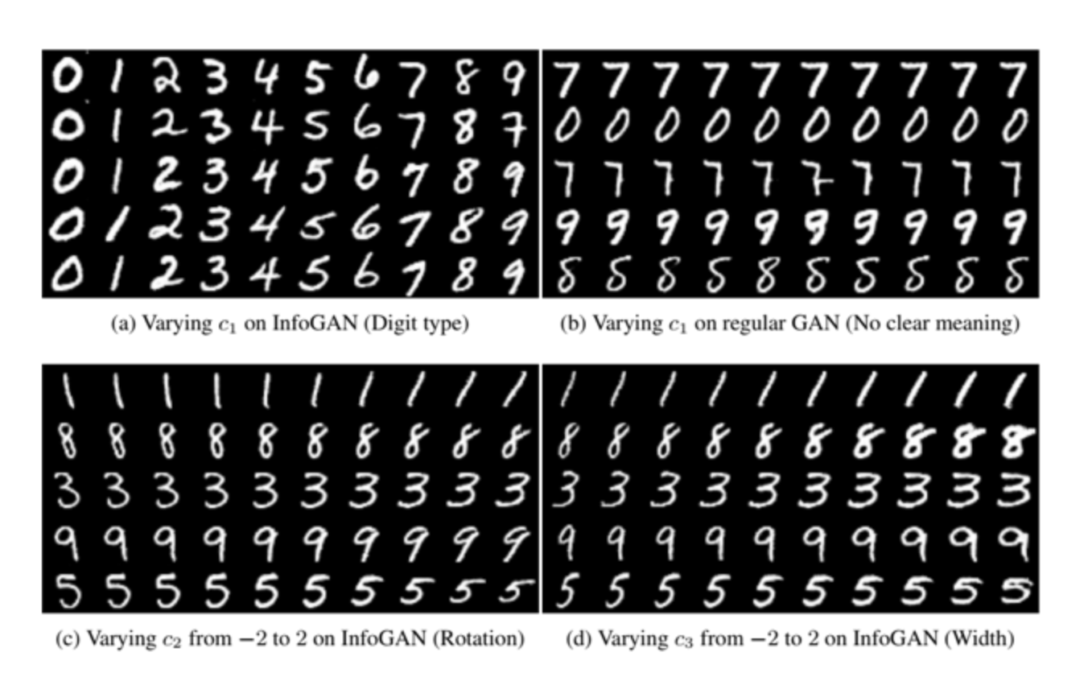
Knob at work

Slide 18
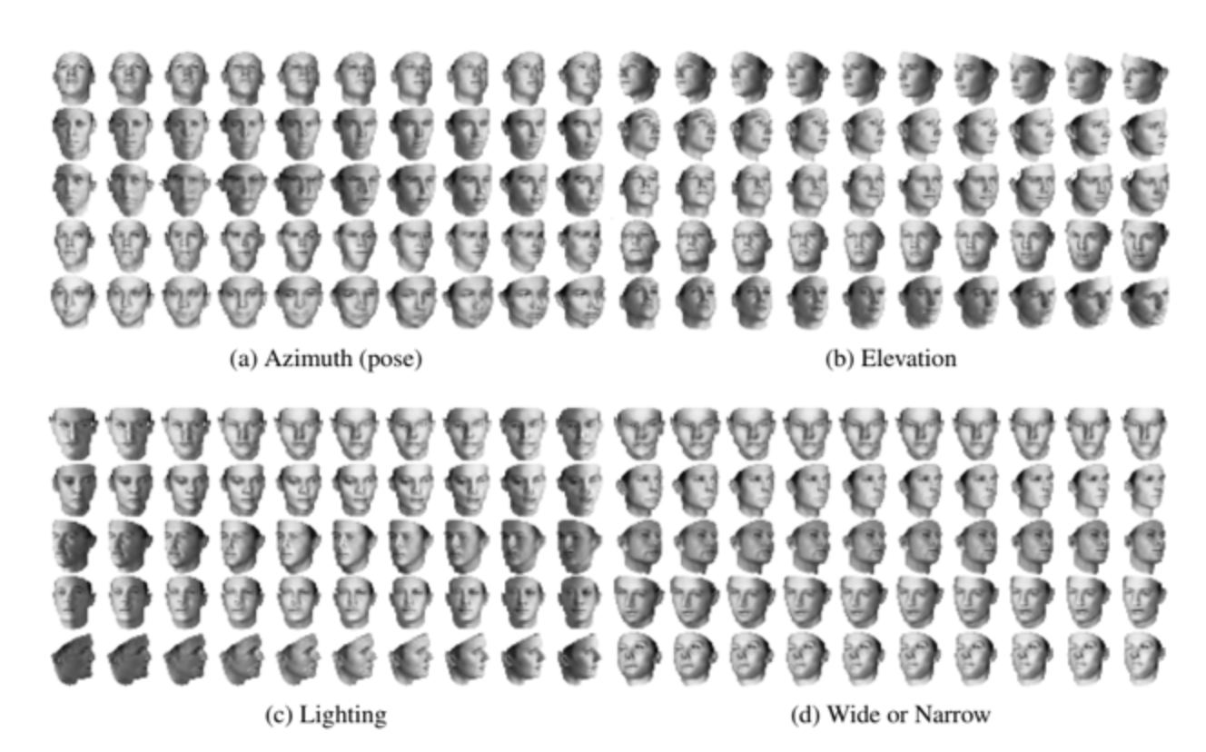
Face Angles

Slide 19
Conditional GANs
GANs take noise z and turn it into our data x
Great! But what if we want to control it?
“It generated another image of a 3? I wanted a 7 this time!”
Conditional GANs:
If we have labels, we want to teach it to generate not just any x, but an x of a particular label when given some noise z

Slide 20
Conditional GANs
Feed the generator both a sample from z and the condition
Discriminator tries to tell real/fake apart as before
The generator could generate really realistic images that don’t match the condition and the discriminator would never know
v
http://guimperarnau.com/blog/2017/03/Fantastic-GANs-and-where-to-find-them

Slide 21
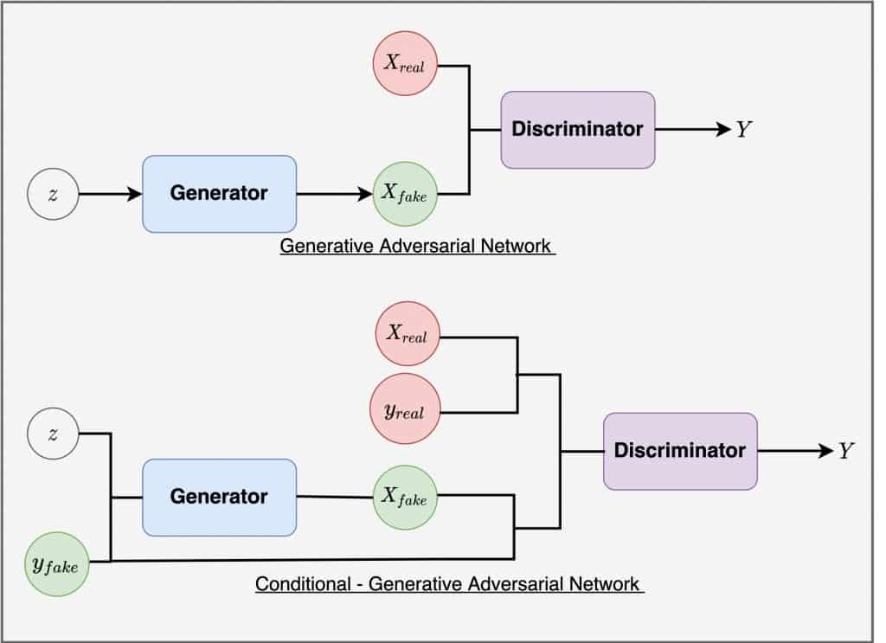
Conditional GANs
Have to also give the discriminator the labels for each point
The discriminator not only looks to see if it is realistic, but also if it is an image/condition pair that doesn’t appear in real data
http://guimperarnau.com/blog/2017/03/Fantastic-GANs-and-where-to-find-them

Slide 22
Can adversarial training be used on Autoencoders ?
Can we use it to make an improved version of a VAE?
Can the role of the KL-divergence penalty be replaced by an adversary?

Slide 23
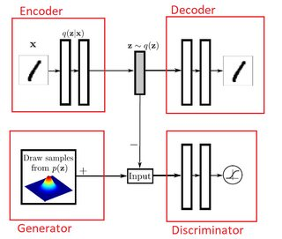
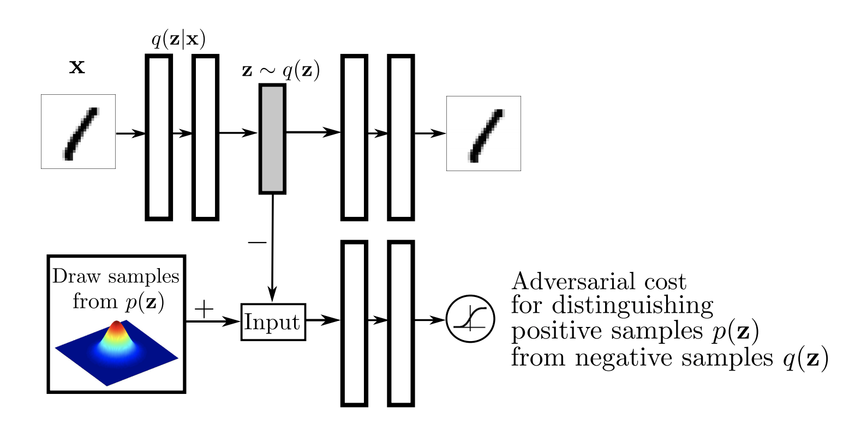
Adversarial Autoencoders
reconstruction loss
Differences
Discriminator classifies samples from z against the AE hidden layer
Low-dimensional and easy distributions
Generator has both encoder and decoder
Generator receives gradient signal from discriminator and reconstruction loss
Makhzani, Alireza, et al. "Adversarial autoencoders." arXiv preprint arXiv:1511.05644 (2015).

Slide 24
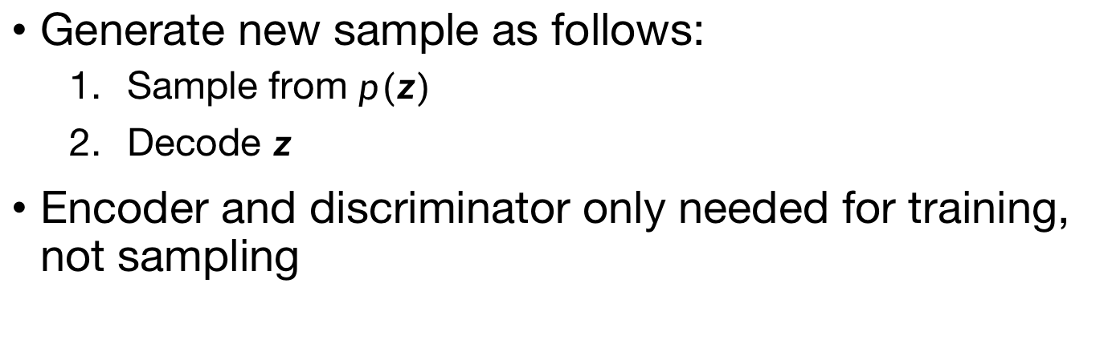
Adversarial Autoencoders
Generate new sample as follows:
Sample from $p(z)$
Decode $z$
Encoder and discriminator only needed for training, not sampling
Makhzani, Alireza, et al. "Adversarial autoencoders." arXiv preprint arXiv:1511.05644 (2015).

Slide 25
Other advantages of AANs
The discriminator has a simpler job: just needs to distinguish between latent layer distribution and gaussian distribution
Has denoising and other advantages of an autoencoder

Slide 26
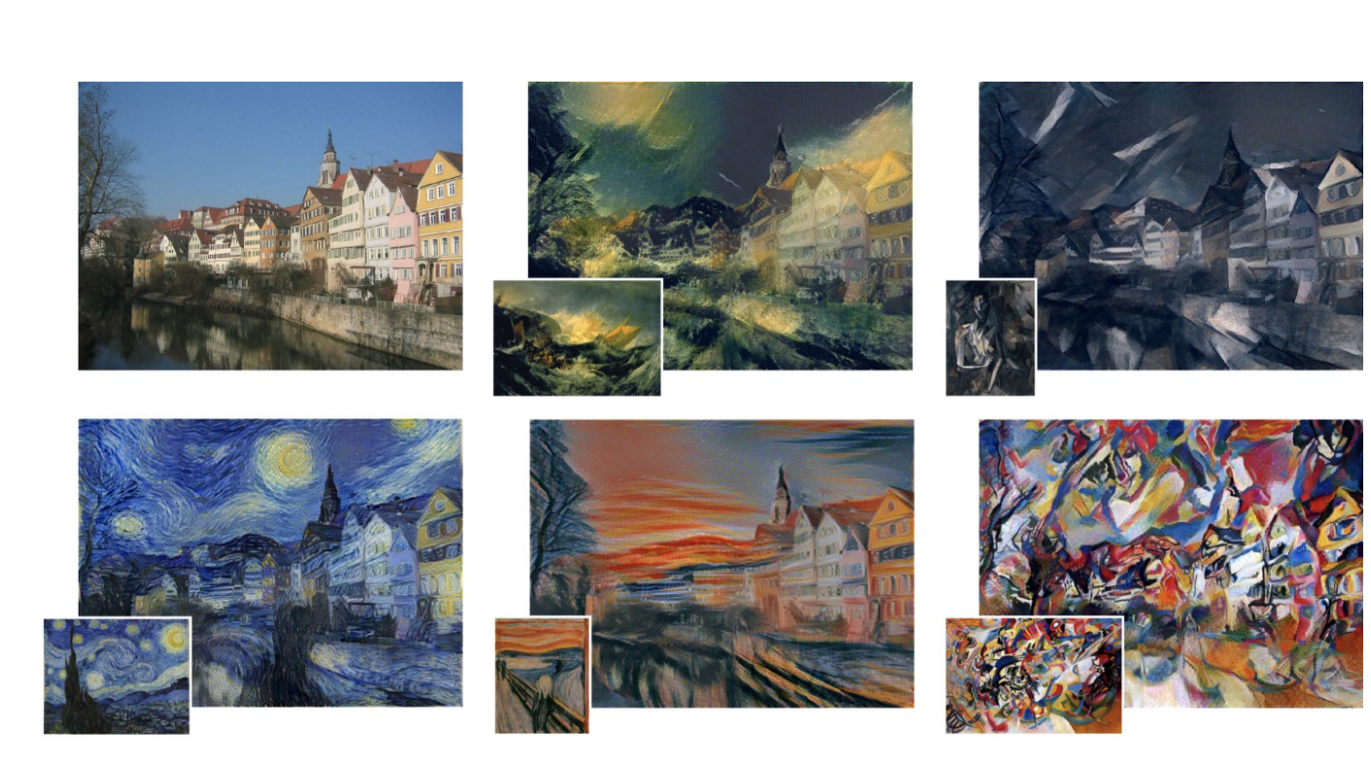
Domain Transfer
Refers to the transfer of data from one domain to another
Example: Style Transfer
From Gatys et al

Slide 27
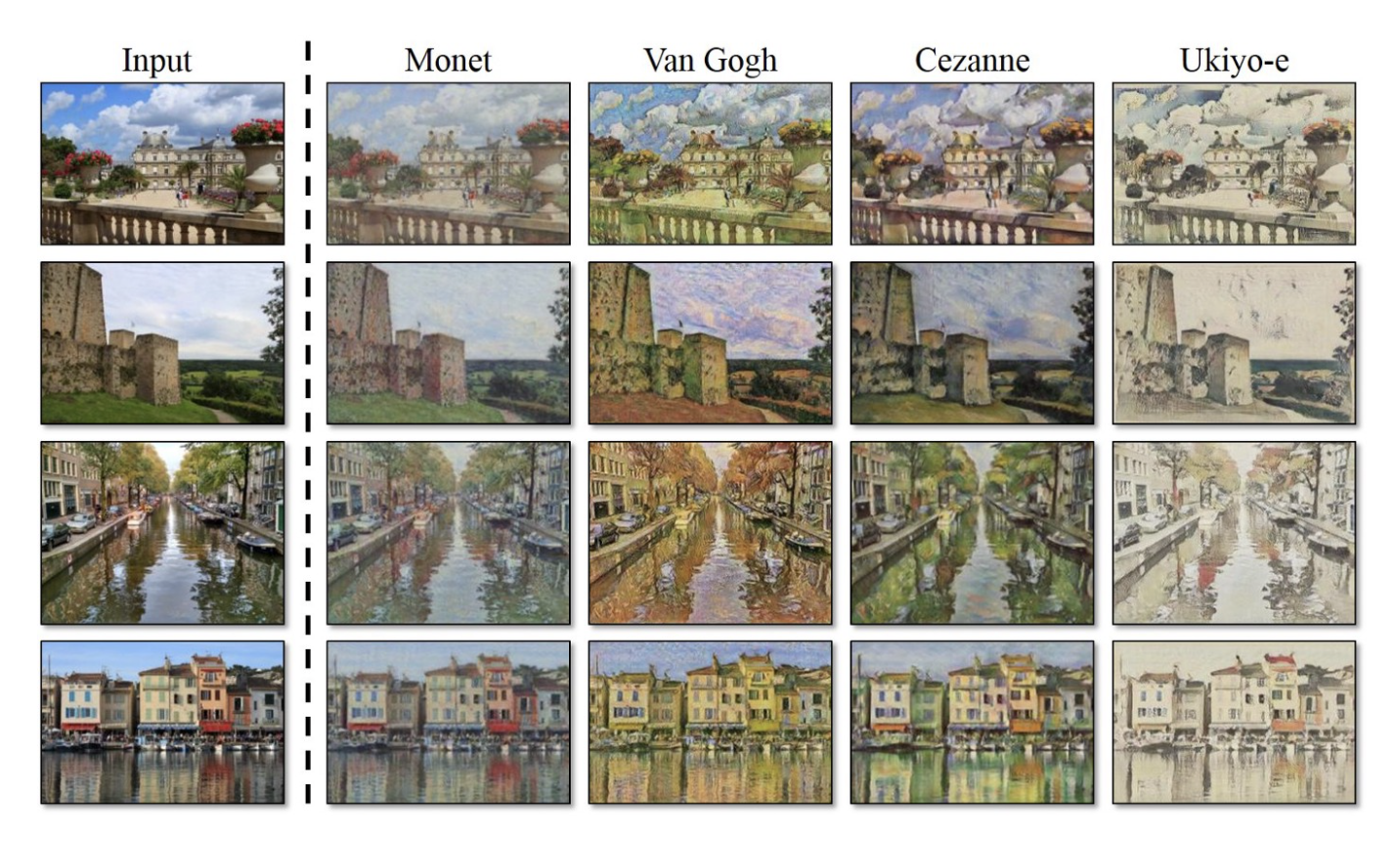
CycleGANs for style transfer
CycleGANs (generically) use two gans, one to transfer from domain A to domain B and one to transfer B to A

Slide 28
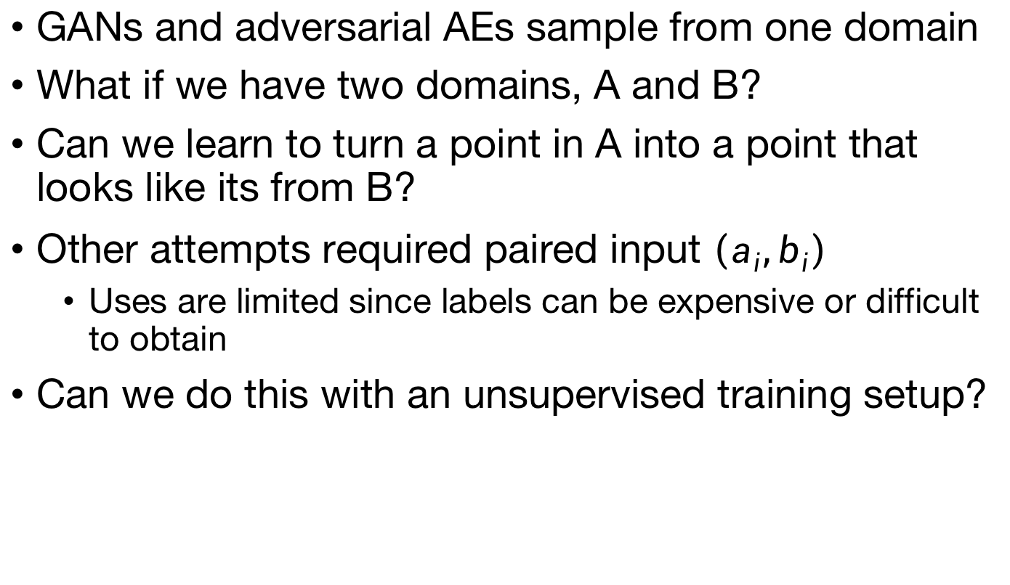
DiscoGAN: Motivation
GANs and adversarial AEs sample from one domain
What if we have two domains, A and B?
Can we learn to turn a point in A into a point that looks like its from B?
Other attempts required paired input $\left(a_{i},b_{i}\right)$
Uses are limited since labels can be expensive or difficult to obtain
Can we do this with an unsupervised training setup?
Notes:
For the paired example, need a black and white image and a colored image to learn how to color a black and white image

Slide 29
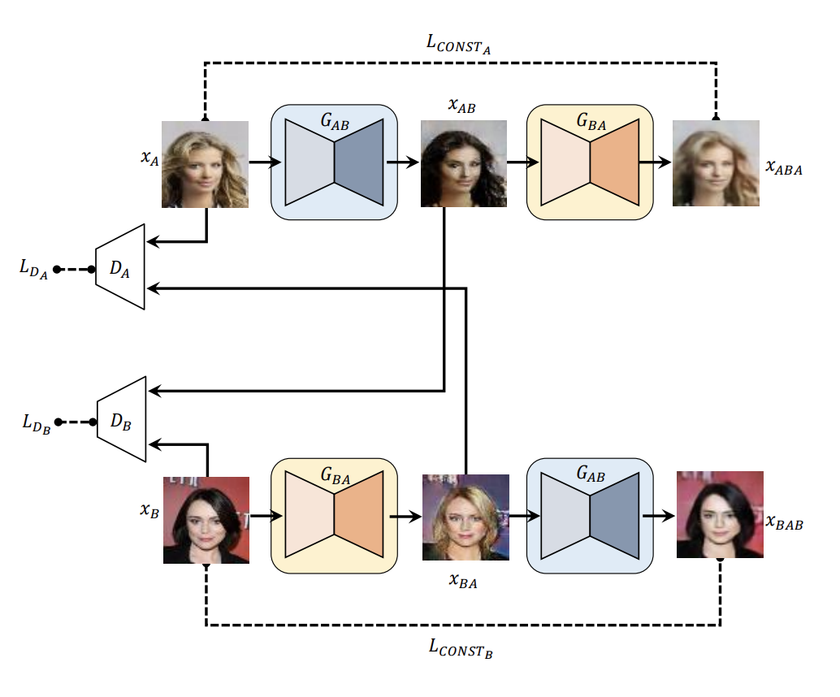
DiscoGAN: Motivation
Domain A: blond hair
Domain B: black hair
Previous approach
Kim, Taeksoo, et al. "Learning to discover cross-domain relations with generative adversarial networks." arXiv preprint arXiv:1703.05192 (2017).
Notes:
Note that the architecture of each of these are only mappings (not autoencoders although they kind of look like it).
This idea was nice, but the results weren’t very good. You would get someone with black hair, but it didn’t look like the person in the original image.

Slide 30
DiscoGAN
Domain A: blond hair
Domain B: black hair
Kim, Taeksoo, et al. "Learning to discover cross-domain relations with generative adversarial networks." arXiv preprint arXiv:1703.05192 (2017).

Slide 31
DiscoGAN
Weight sharing/reuse is important
Same network weights/activations must perform multiple tasks
Indirectly increases number of training samples and generalizability
Reduces number of weights to train
Optimization is easier
Kim, Taeksoo, et al. "Learning to discover cross-domain relations with generative adversarial networks." arXiv preprint arXiv:1703.05192 (2017).

Slide 32
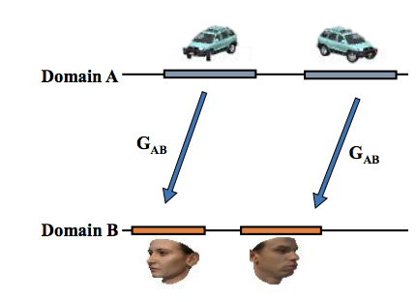
DiscoGAN
Weight sharing/reuse is important
Same reason CNNs work
Same network weights/activations must perform multiple tasks
Indirectly increases number of training samples and generalizability
Reduces number of weights to train
Optimization is easier
Kim, Taeksoo, et al. "Learning to discover cross-domain relations with generative adversarial networks." arXiv preprint arXiv:1703.05192 (2017).

Slide 33
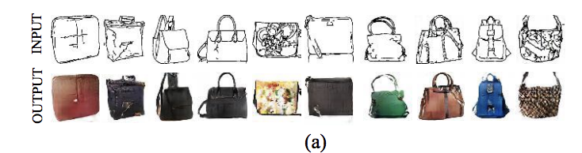
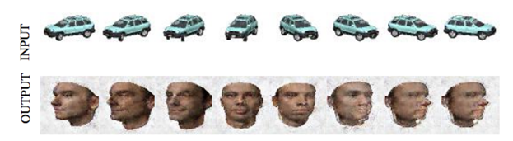
DiscoGAN

Slide 34
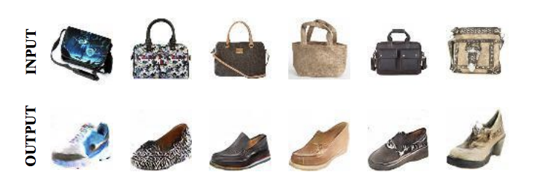
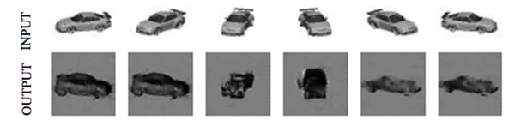
DiscoGAN
Issues
Is this the correct shoe for this purse?
Is there a better match?
Original paper doesn’t talk about it
Sometimes the mapping isn’t correct
Notes:
Later paper showed that DiscoGAN sometimes was essentially counting pixels to match (e.g., the blue shoe)

Slide 35
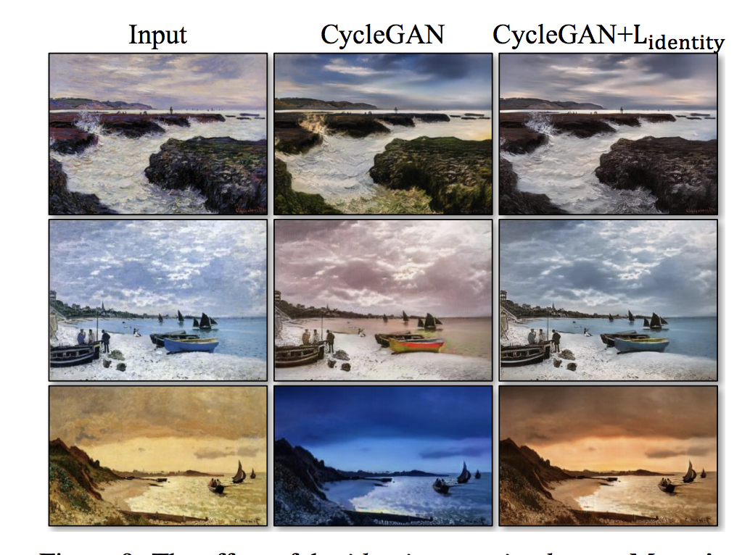
CycleGAN
Came out shortly after DiscoGAN, popularized the idea
Added another component to the loss:
Normally G_{AB} takes x_{A} to domain B
This means G_{AB}(x_{A}) will be different from x_{A}
Add additional constraint that G_{AB}(x_{B}) = x_{B}
Intuitively, G should take something not in A to B, but if it’s already in B, it shouldn’t change it
Zhu, Jun-Yan, et al. "Unpaired image-to-image translation using cycle-consistent adversarial networks." Proceedings of the IEEE International Conference on Computer Vision. 2017.

Slide 36
Limitations of Cycle-consistency
Can only learn simple style-transfer transformations
e.g. paint a horse to look like a zebra
Can only learn one transformation
e.g. all horses become zebras, and nothing else is transformed
Thus domains must be homogenous
Papers do a lot of cropping and centering…
Transform based on the pixel space
Is MSE between two 256x256x3-dimensional images meaningful?
Assumes any invertible transformation is meaningful
What does invertibility have to do with semantic meaning?
Not interpretable
Why did individual i in domain 1 get paired with this particular individual in domain 2? CycleGAN offers no insight into its decision

Slide 37
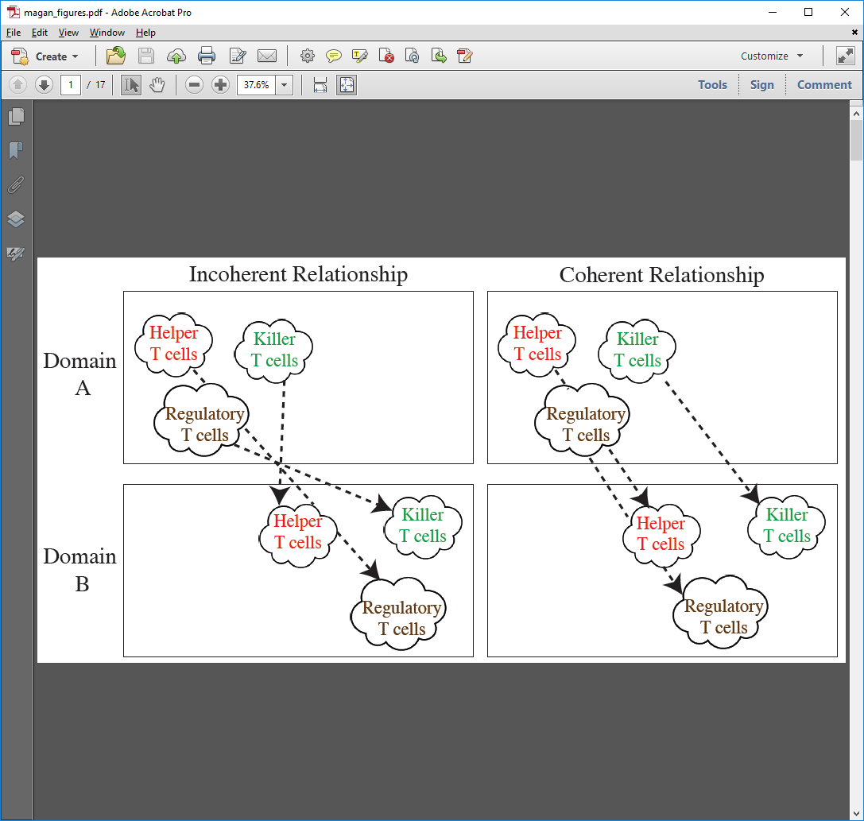
Manifold Alignment GAN (MAGAN)
Amodio & Krishnaswamy (2018)
Consider manifolds A and B to be two CyTOF panels
Different markers, samples from same tissue
Panel A measures 40 markers
Panel B measures 40 markers
10 shared markers and 30 unique markers, each
Using 10 shared markers, find corresponding cells across panels
Superimposing Manifolds
Aligning Manifolds

Slide 38
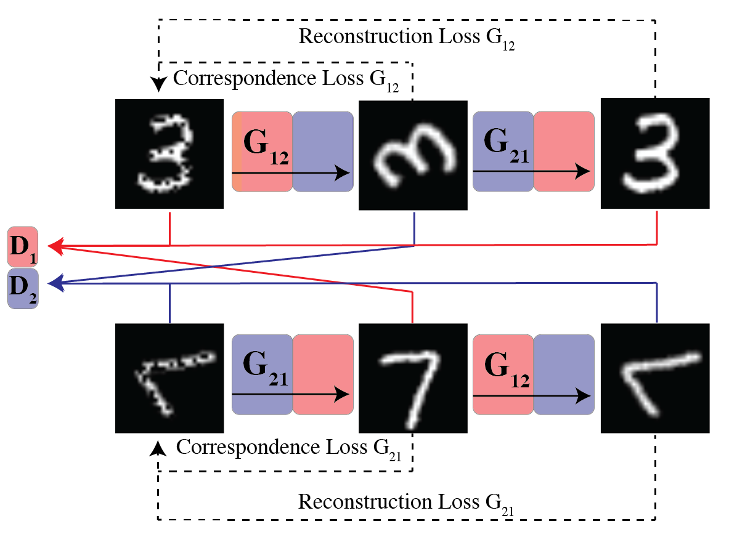
MAGAN Architecture
Notes:
DiscoGAN hopes that if you’re regenerating a 3, then the middle layer should look like a 3 too. But nothing directly enforces that. By adding a correspondence loss, this forces them to be the same.
Example: CyTOF with shared channels. Force the shared channels to match each other.

Slide 39
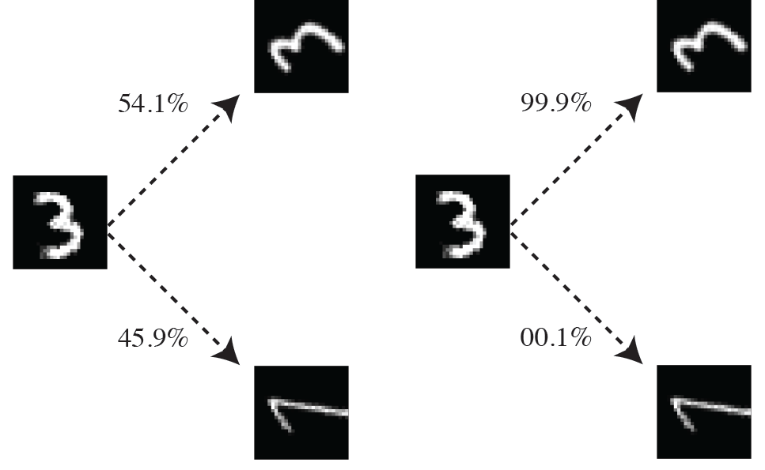
Matching rotated digits
100 simulations of each model
GAN w/o Correspondence
MAGAN
Notes:
Correspondence in this case was a semi-supervised approach where a single pair of samples was given

Slide 40
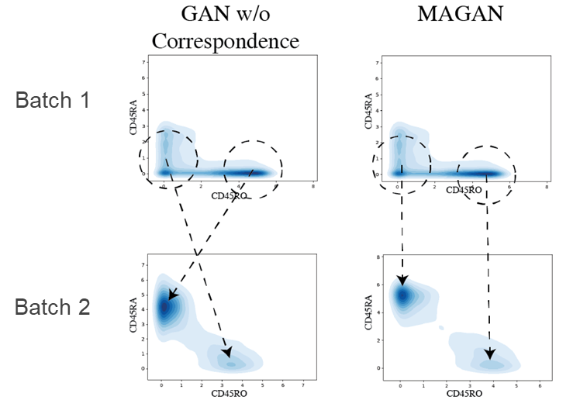
Aligning CyTOF Batches w/ MAGAN
Two underlying cell populations measured in each batch (naïve T cells and central memory T cells)
Dropout in CD45RA in batch 1
MAGAN correctly matches the cell types in the two batches

Slide 41
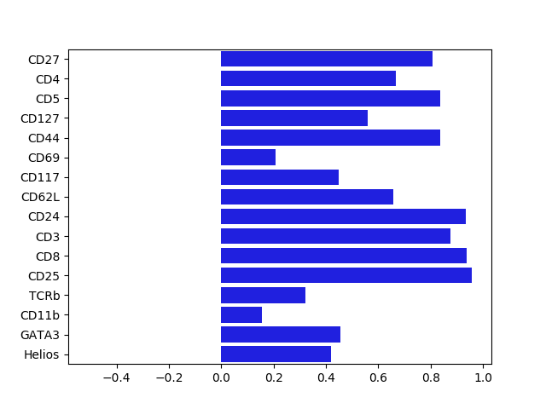
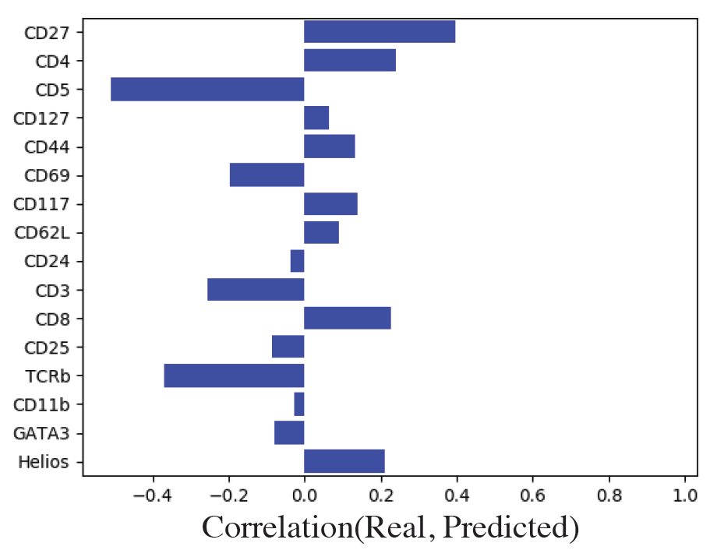
Aligning CyTOF Panels w/ MAGAN
Validation on publicly available CyTOF data from developing mouse brain*
Hold out a shared marker in one panel
Apply MAGAN to reconstruct held-out marker
Compare correlation between real value and prediction
GAN w/o Correspondence
MAGAN
* Setty, Manu et al. “Wishbone identifies bifurcating developmental trajectories from single-cell data“. Nature Biotechnology.

Slide 42
Limitations of Cycle-consistency
Can only learn simple style-transfer transformations
e.g. paint a horse to look like a zebra
Can only learn one transformation
e.g. all horses become zebras, and nothing else is transformed
Thus domains must be homogenous
Papers do a lot of cropping and centering…
Transform based on the pixel space
Is MSE between two 256x256x3-dimensional images meaningful?
Assumes any invertible transformation is meaningful
What does invertibility have to do with semantic meaning?
Not interpretable
Why did individual i in domain 1 get paired with this particular individual in domain 2? CycleGAN offers no insight into its decision

Slide 43
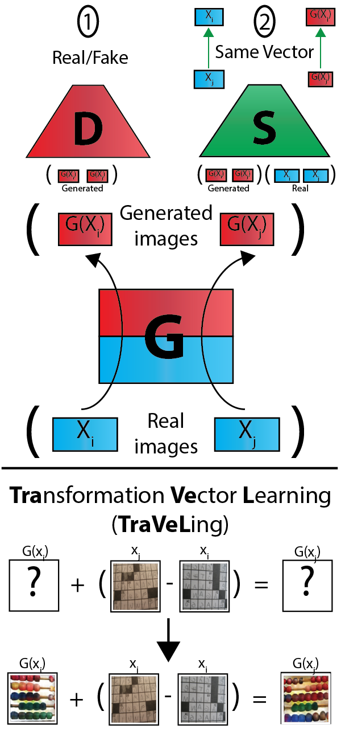
TraVeLGAN
Instead of enforcing cycle-consistency, enforce that the vector between two real points is the same as the vector between their corresponding two generated points
Key: do this in a latent space, not pixel space!
Where do we get this latent space?
Learn another network (S) to go along with G and D to find a latent space where these transformations are preserved
Train S alongside the other networks, gradually developing an appropriate semantics
Since we are no longer enforcing pixel-wise MSE with cycle-consistency, we have a lot more freedom to change the image for domain transfer now

Slide 44
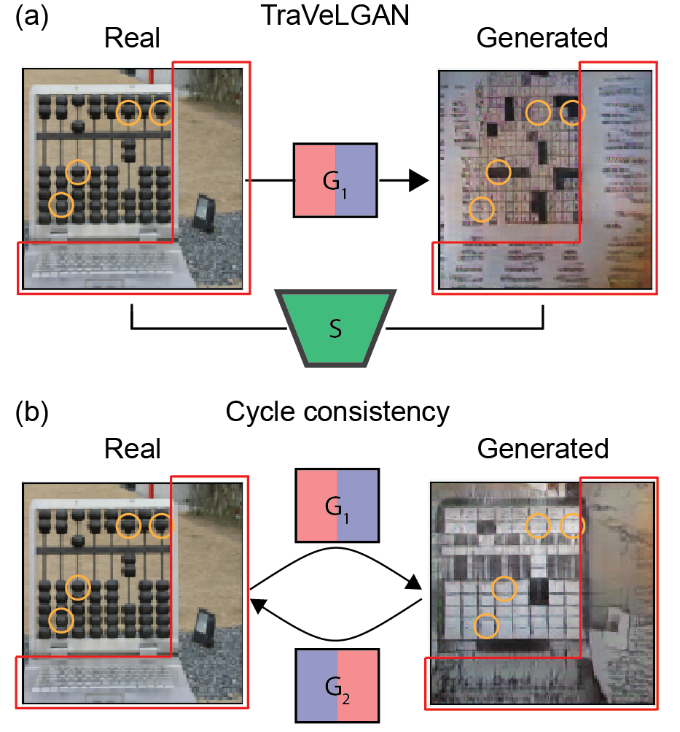
TraVeLGAN: examples
Transferring abaci to crosswords
The desired function is not invertible
Any crossword configuration is a valid abacus configuration, but the reverse is not true
Changes to the background of an image usually have to be lossy, which we can’t have if we require pixel-wise cycle-consistency

Slide 45
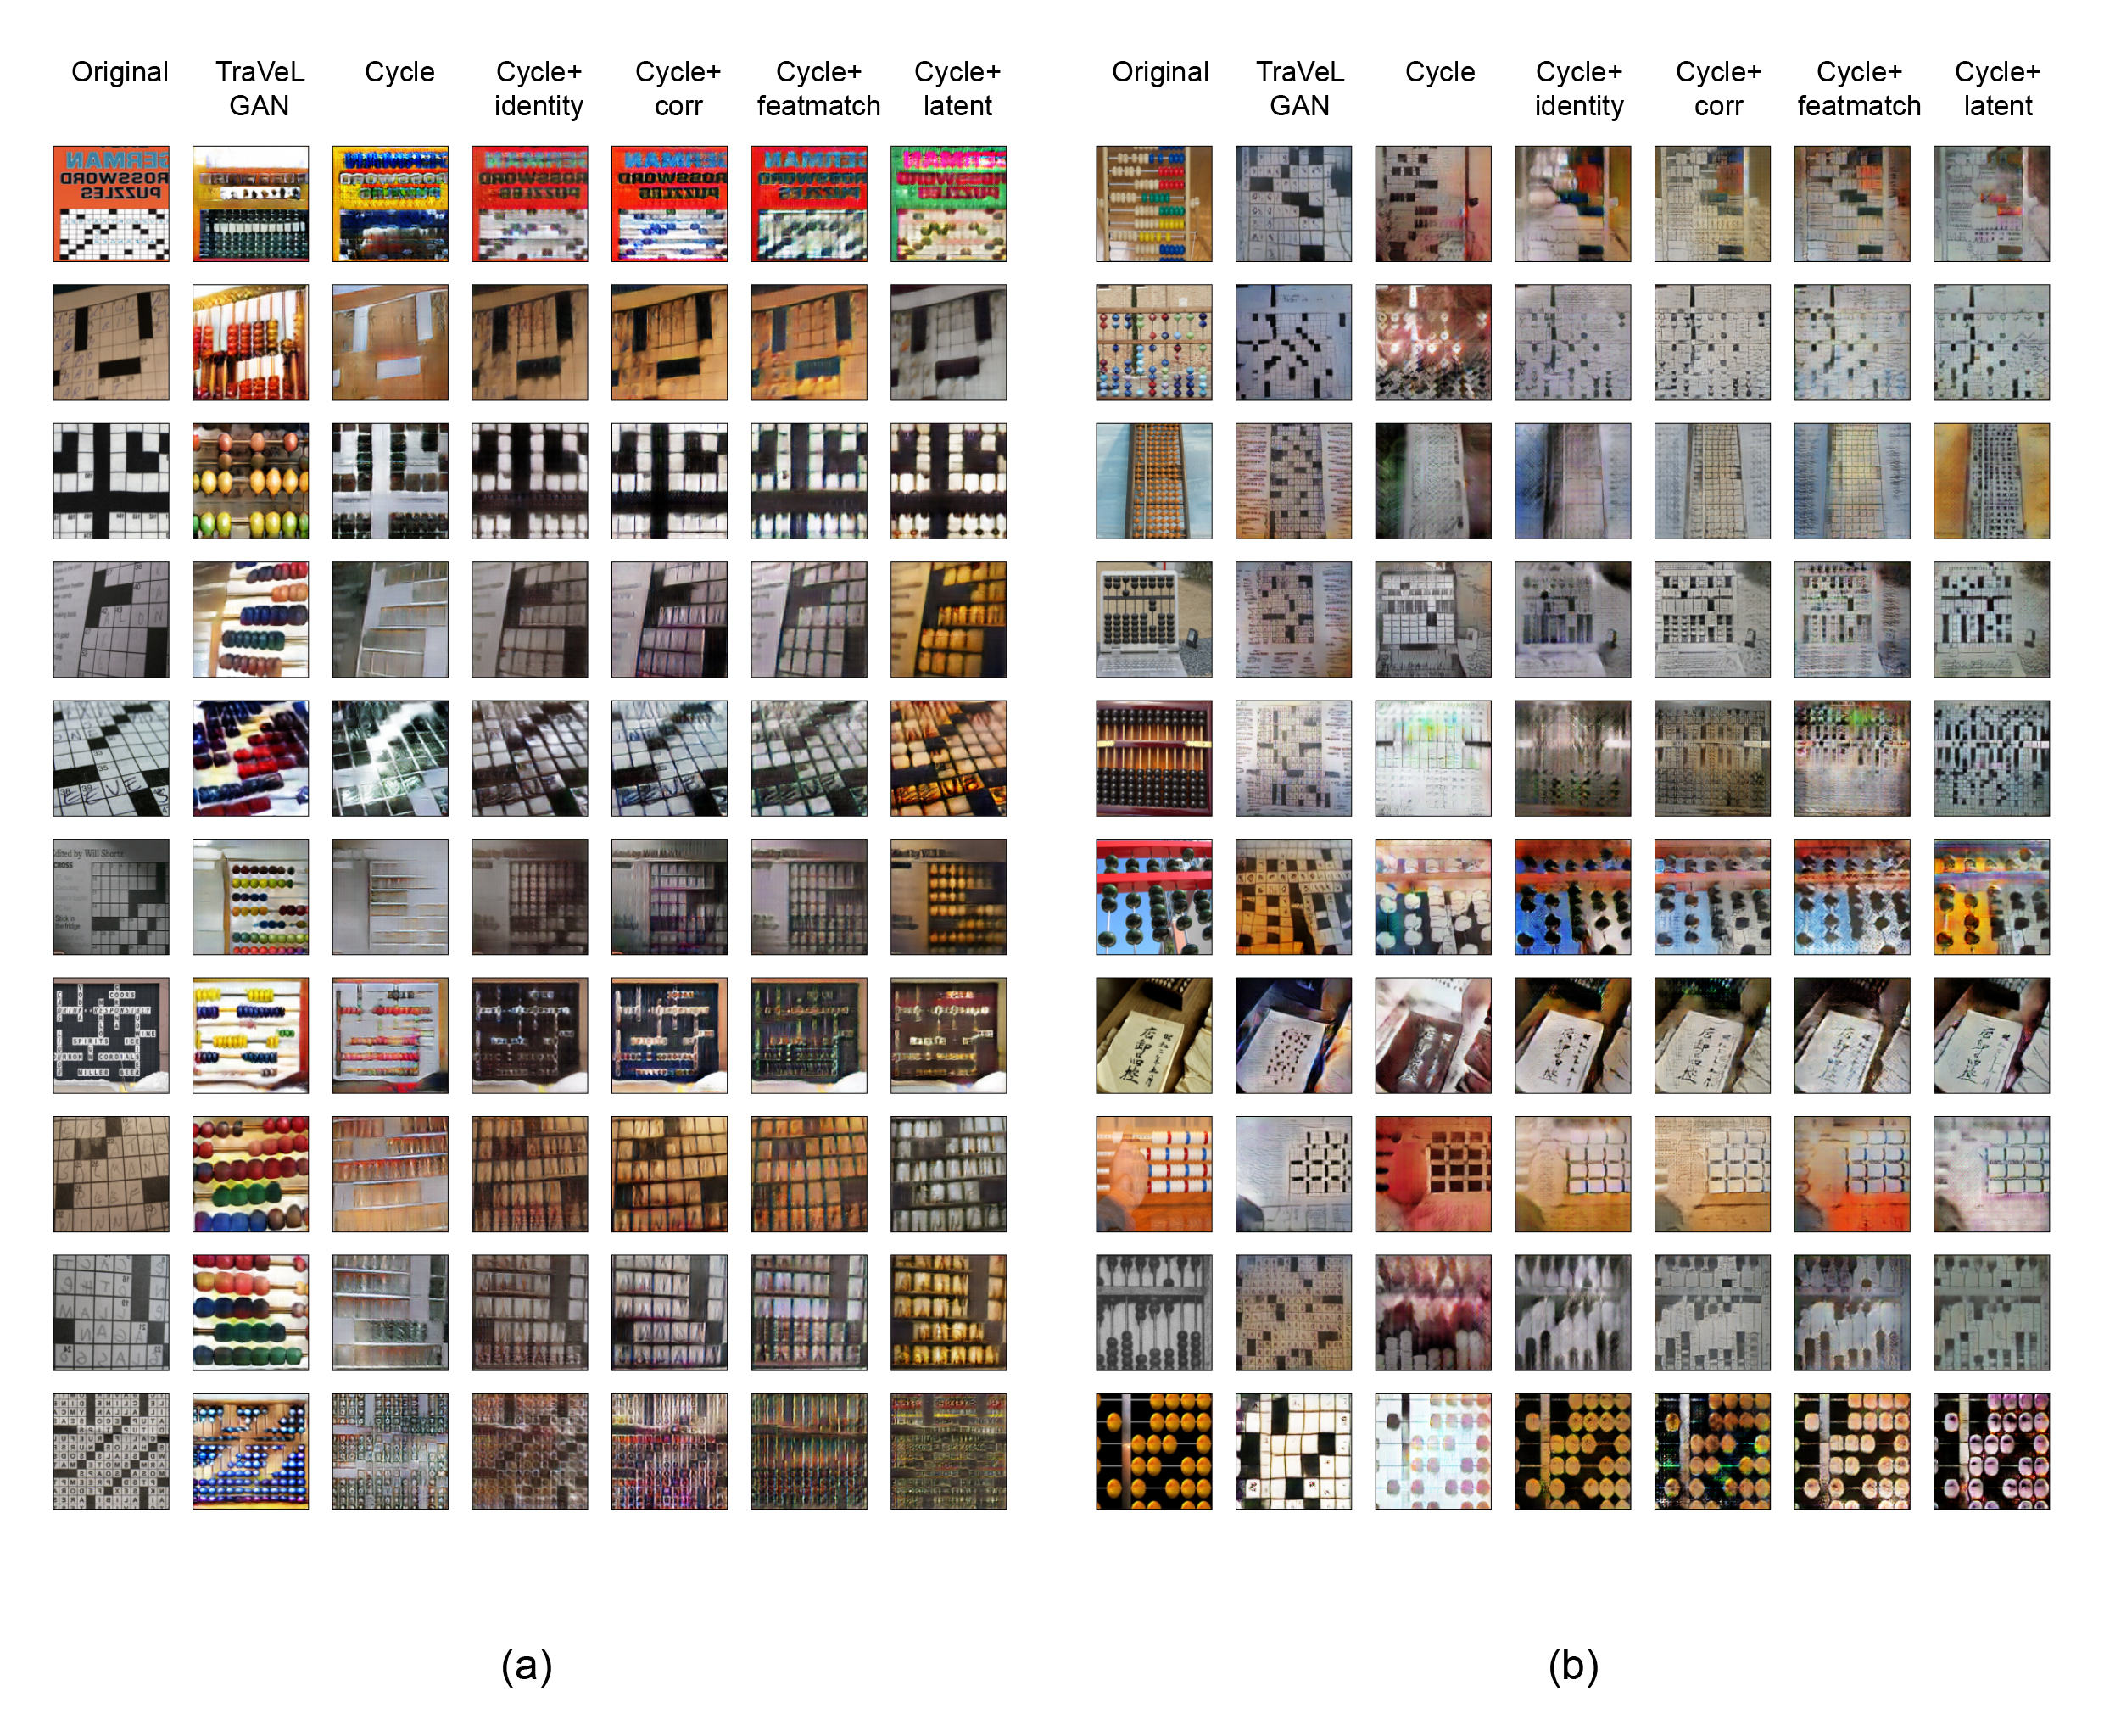
TraVeLGAN: examples

Slide 46
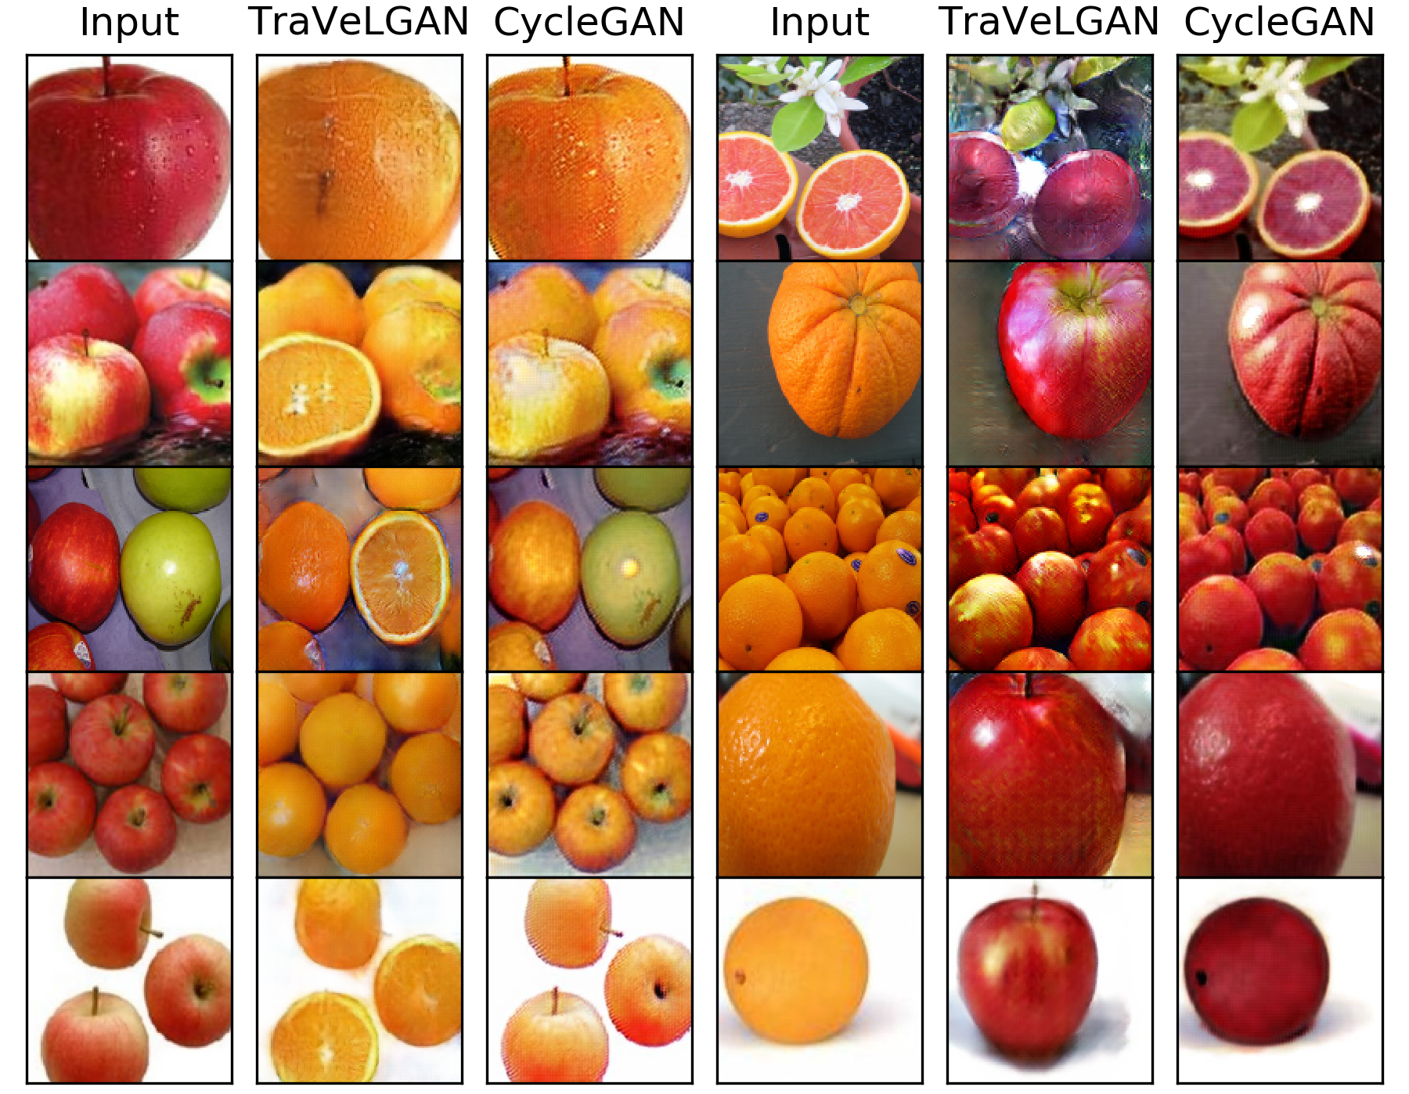
TraVeLGAN: examples

Slide 47
Further reading
Goodfellow et al., Section 20.10.4
Lectures on GANs CS 11-785 at CMU
Goodfellow et al., Section 20.10.4
Lectures on GANs CS 11-785 at CMU
StyleGAN: https://arxiv.org/pdf/1812.04948.pdf
InfoGAN: https://arxiv.org/pdf/1606.03657.pdf
DiscoGAN: https://arxiv.org/abs/1703.05192
CycleGAN: https://arxiv.org/abs/1703.10593
MAGAN: http://proceedings.mlr.press/v80/amodio18a.html
TraVeLGAN: https://arxiv.org/abs/1902.09631
Conditional GAN: https://arxiv.org/pdf/1411.1784.pdf

